Slide 1

Medical Diagnosis Assistant: A RAG-Based Solution
Our project aims to develop a medical diagnosis assistant. It uses Retrieval-Augmented Generation (RAG) to aid medical professionals. We will improve diagnostic accuracy. This enhances efficiency. It will support clinical decision-making.
Team Members:
Shajahan Sayyed

Slide 2

Project Topic & Domain
Domain
Our project focuses on medical diagnosis assistance. The corpus will include textbooks and research papers.
Sources include the Mayo Clinic database and NIH. We will leverage comprehensive medical knowledge.
Rationale
We will enhance diagnostic accuracy. We will also improve efficiency.

Slide 3

Project Objectives
1
Primary Objective
Create a RAG system for diagnostic suggestions based on symptoms. It will also consider medical history.
2
Integrate Diverse Sources
We will integrate and index a range of medical knowledge sources.
3
Implement Retrieval
We will use efficient retrieval to identify relevant information.
4
User-Friendly Interface
We will design an interface for medical professionals.

Slide 4





Value Proposition
Improved Accuracy
Enhanced Efficiency
Decision Support
Accessibility
Reduce diagnostic errors with access to knowledge. Expedite the diagnostic process to save time. We provide evidence-based insights. Expert knowledge becomes accessible to providers. Telemedicine, powered by AI, is projected to grow.

Slide 5

State of the Art in RAG Systems
1
Overview
RAG combines retrieval and generation. It supports knowledge-intensive tasks.
2
Key Works
Lewis et al. (2020) demonstrated RAG in question answering. Guu et al. (2020) showed RAG improves language models.
3
Limitations
Common limitations include hallucinations. Knowledge bases may also be limited.
4
Medical Domain
Growing interest exists in disease prediction. Treatment suggestion are of particular interest.

Slide 6



Approach & System Architecture
Knowledge Base
Curated dataset of medical resources. We are including FAISS for search.
Retrieval
Semantic search to identify relevant documents.
Generation
LLM generates diagnostic suggestions. It will include supporting evidence.
We plan to use Llama 2 (70B) or Med-PaLM. The input is patient data. The output is potential diagnoses. We will rank diagnoses with confidence scores.

Slide 7

Deliverables
Functional System
Documentation
A prototype medical diagnosis assistant will be made.
Detailed system documentation will be produced. This will include architecture and data sources.
Evaluation Report
A comprehensive evaluation of system performance will be delivered.
The deliverables will also include an open-source code repository. We will demo the final functioning system.

Slide 8
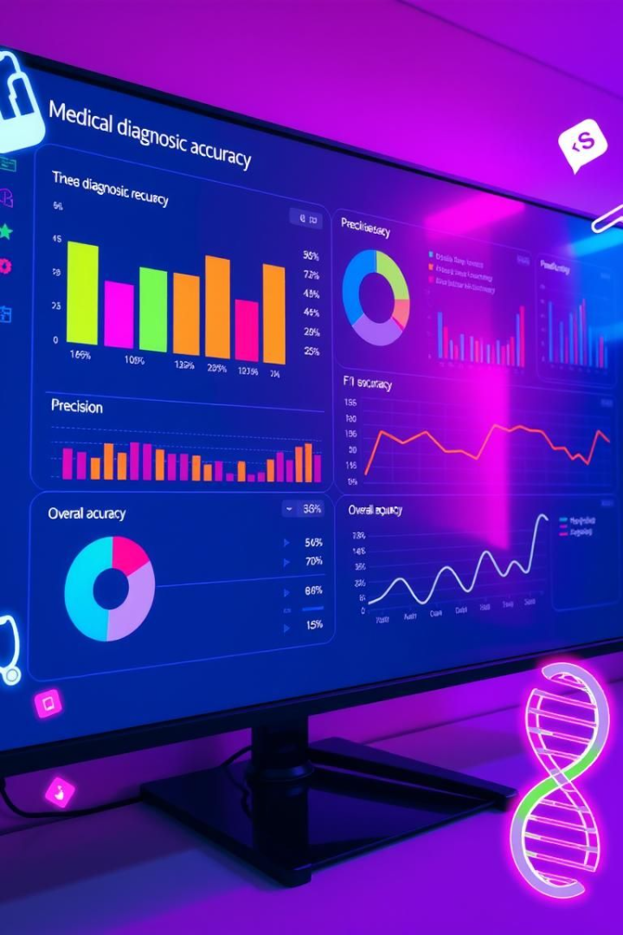
Evaluation Methodology
Evaluation Metrics:
Relevance of retrieved documents (Precision, Recall)
Output quality: BLEU, ROUGE, BERTScore
Medical Accuracy: Human-in-the-loop evaluation by medical student or via benchmark QA datasets
RAG vs LLM Comparison: Using identical prompts with/without retrieval
We will evaluate diagnostic accuracy. We will also measure relevance and coherence. Medical professionals will assess the system. We will compare to baseline LLMs.

